Slide 1
GR 5243 Applied Data Science
Project 4 Algorithm Implementation and Evaluation
Yu, Chenghao (cy2475)
Team Members:
Chen, Jannie (mc4398) Chen, Sizhu (sc4248) Li, Yunfan (yl3838) Xu, Zhengyang (zx2229)

Slide 2
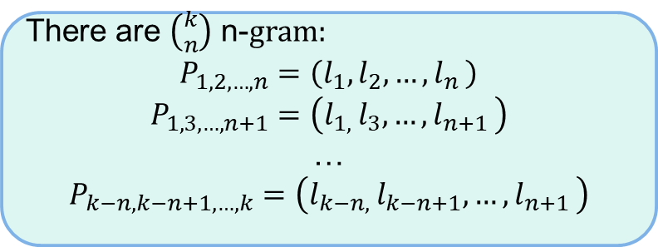
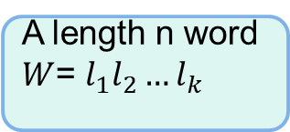
Detection: Binary n-Grams Method (D-2)
Idea:
Check whether letter pairs in the word at different positions exists in ground truth. If any pairs of letters are not in ground truth, the word is detected as error.
Concepts:
n-Grams
There are $\left({k \atop n}\right)$ n-$gram:$
$$P_{1,2,…,n}=\left(l_{1},l_{2},{…,l}_{n}\right)$$
$$P_{1,3,…,n+1}=\left(l_{1, }l_{3},{…,l}_{n+1}\right)$$
…
$$P_{k−n,k−n+1,…,k}=\left(l_{k−n, }l_{k−n+1},{…,l}_{n+1}\right)$$
A length n word $W$= $l_{1}l_{2}{…l}_{k}$

Slide 3
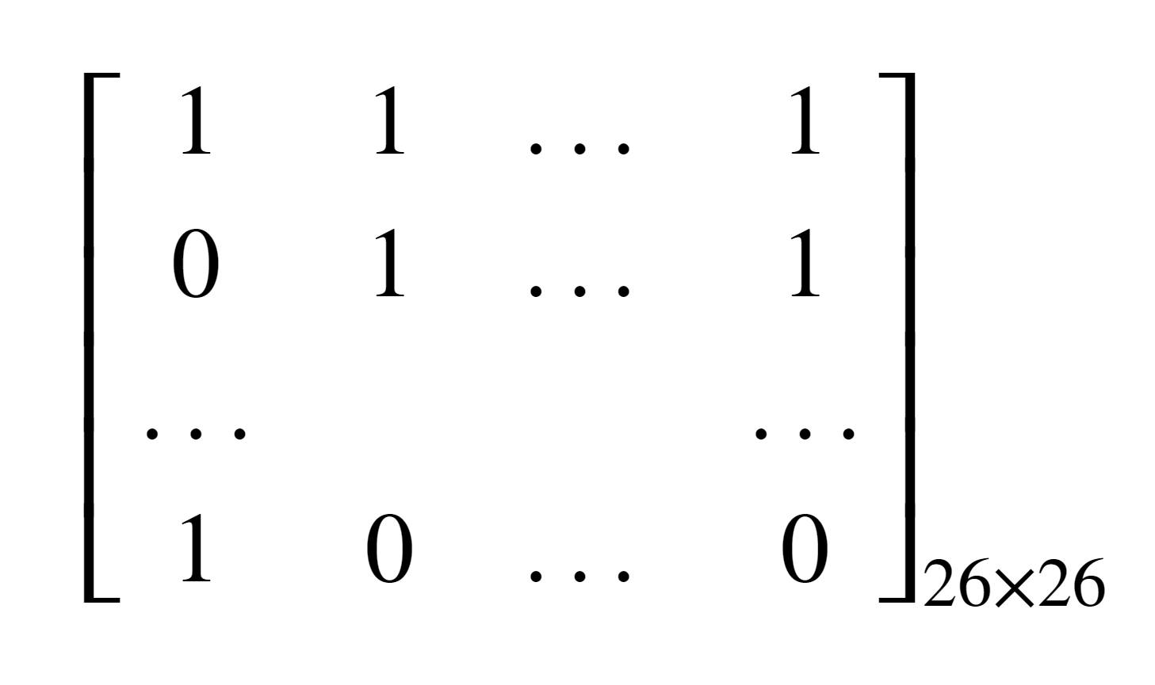
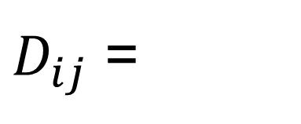
Detection: Binary n-Grams Method (Cont.)
Binary 2-gram Matrix:
a b … z
a b … z
$D_{ij}$ =

Slide 4
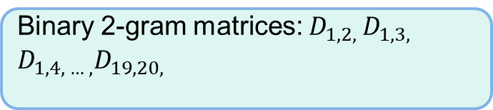
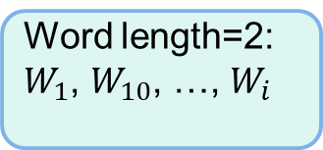



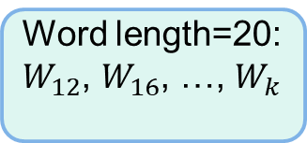
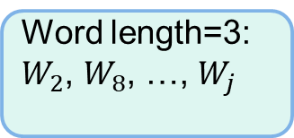
Detection: Binary n-Grams Method (Cont.)
Creating Binary Matrices:
Create all binary 2-gram matrices
Word length=2:
$W_{1}$, $W_{10}$, …, $W_{i}$
Binary 2-gram matrices: $D_{12}$
Ground truth text:
$W_{1}$, $W_{2}$, …, $W_{n}$
Word length=3:
$W_{2}$, $W_{8}$, …, $W_{j}$
Binary 2-gram matrices: $D_{1,2, }D_{1,3, }$ $D_{2,3, }$
…
Word length=20:
$W_{12}$, $W_{16}$, …, $W_{k}$
Binary 2-gram matrices: $D_{1,2, }D_{1,3, }$ $D_{1,4, … ,}D_{19,20, }$

Slide 5
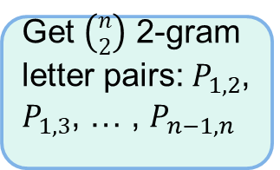
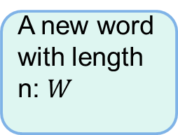
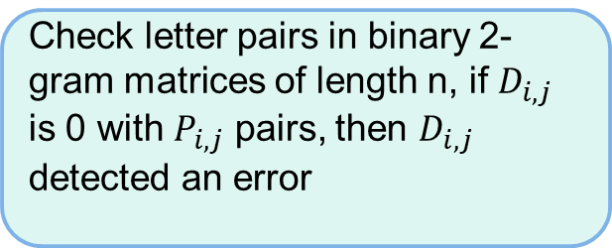
Detection: Binary n-Grams Method (Cont.)
Detection:
Check letter pairs in binary 2-gram matrices of length n, if $D_{i,j}$ is 0 with $P_{i,j}$ pairs, then $D_{i,j}$ detected an error
A new word with length n: $W$
Get $\left({n \atop 2}\right)$ 2-gram letter pairs: $P_{1,2}$, $P_{1,3}$, … , $P_{n−1,n}$
Find union set of the locations where detected the error happened, the result is the error location in the word.
Assumption:
Only one error in every ORC output word

Slide 6
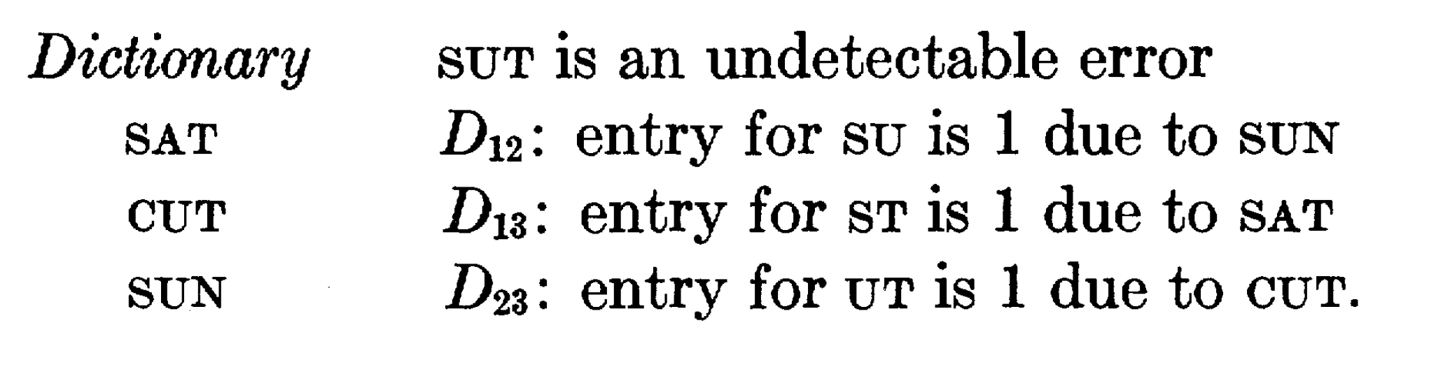
Detection: Binary n-Grams Method (Cont.)
Undetectable Case:

Slide 7
Detection: Binary n-Grams Method (Cont.)
Advantages:
Saving storage space
More efficient than dictionary based methods
Extendability
Disadvantages:
Theoretical Undetectable case
Lower detection rate than dictionary based methods
Cannot detecte errors in non-alphabetic languages

Slide 8
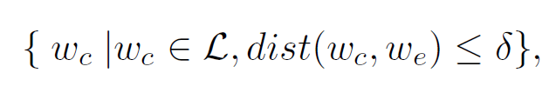
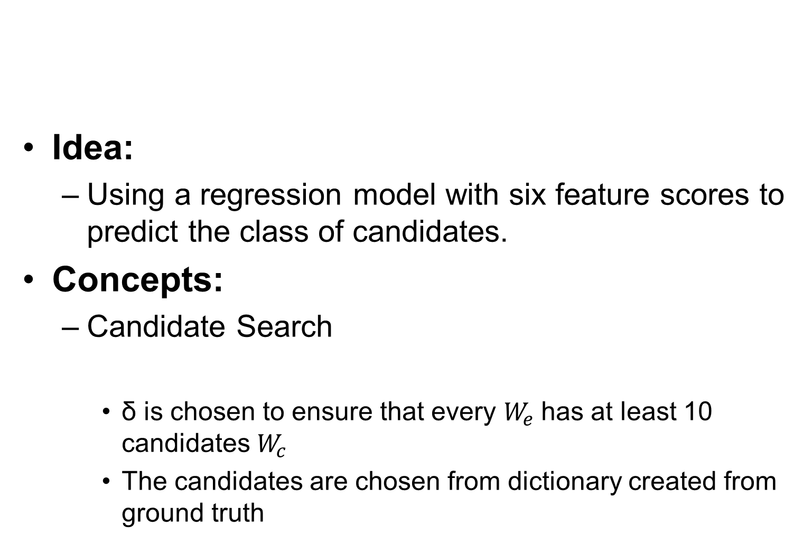
Correction: Statistical Learning Model (C-2)
Idea:
Using a regression model with six feature scores to predict the class of candidates.
Concepts:
Candidate Search
δ is chosen to ensure that every $W_{e}$has at least 10 candidates $W_{c}$
The candidates are chosen from dictionary created from ground truth
Damerau-Levenshtein distance

Slide 9
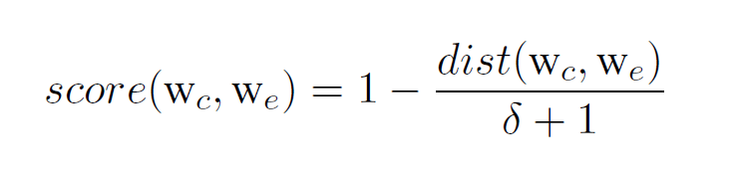
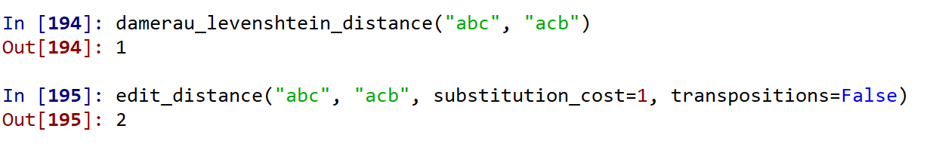
Correction: Statistical Learning Model (C-2)
Feature scores（some kinds of measurement of similarity between two strings):
Feature 1： Levenshtein edit distance score:
δ is chosen by CV to max the average scores for the ground truth
Levenshtein distance
Difference between two edit distance:

Slide 10
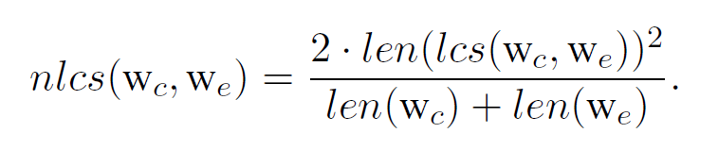
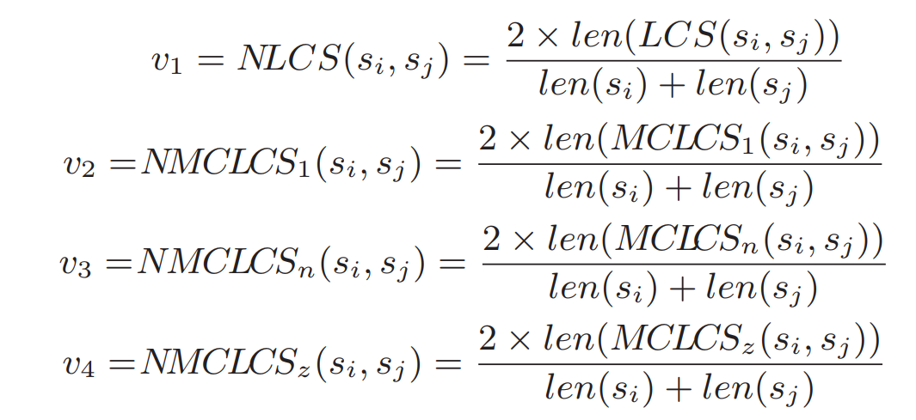
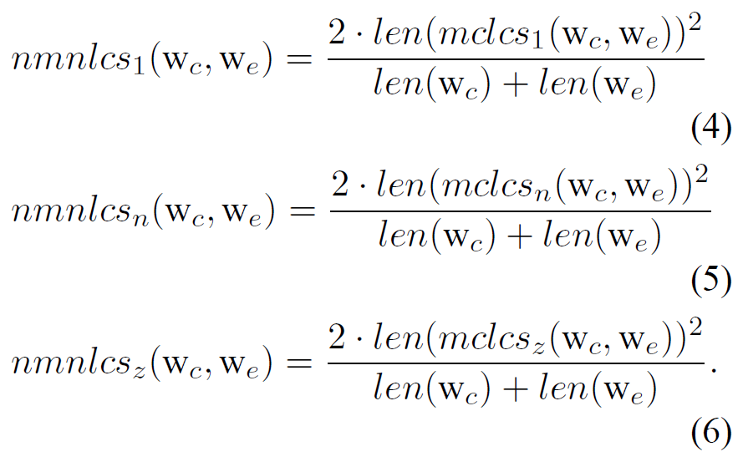
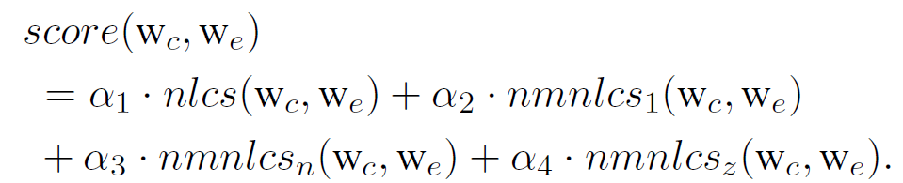
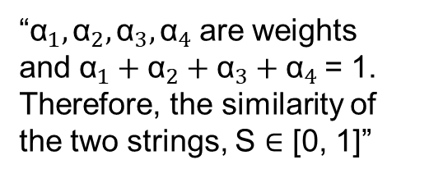
Correction: Statistical Learning Model (Cont.)
Feature 2： String similarity score:
C-2 paper:
Original paper:
“${\text{α}}_{1},{\text{α}}_{2},{\text{α}}_{3},{\text{α}}_{4}$are weights and ${\text{α}}_{1}+{\text{α}}_{2}+{\text{α}}_{3}+{\text{α}}_{4}$= 1. Therefore, the similarity of the two strings, S ∈ [0, 1]”
“We heuristically set equal weights for most of our experiments”

Slide 11
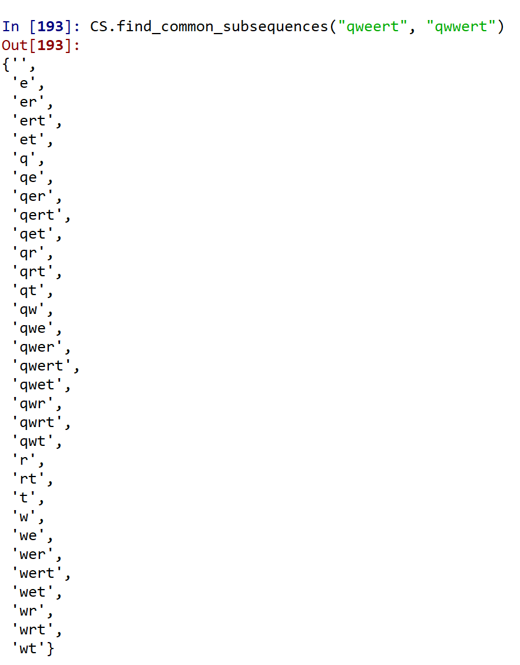


Correction: Statistical Learning Model (Cont.)
LCS: Longest Common Subsequence
lcs$,$ ${\text{mclcs}}_{1},{\text{mclcs}}_{z}$
$${\text{mclcs}}_{n}$$

Slide 12
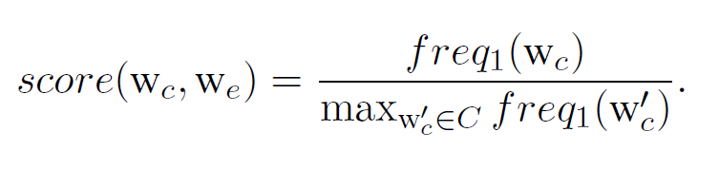
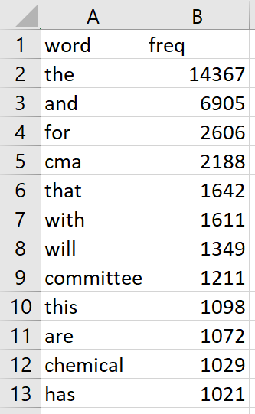
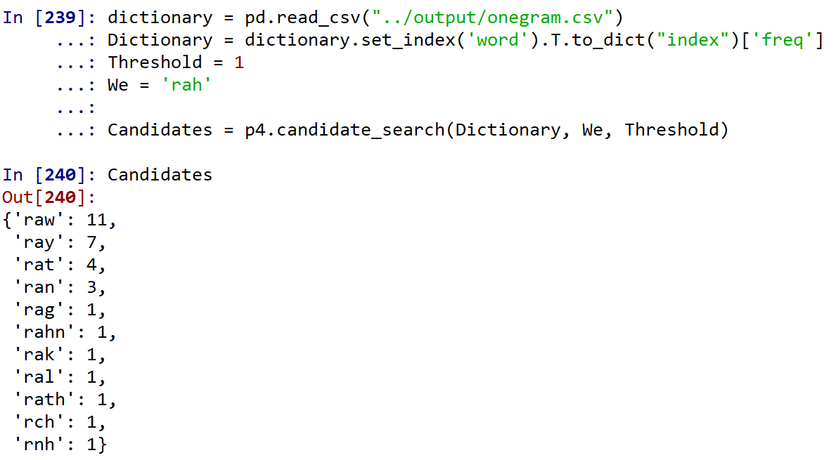
Correction: Statistical Learning Model (Cont.)
Feature 3： Language popularity score:
Dictionary:
Example:

Slide 13
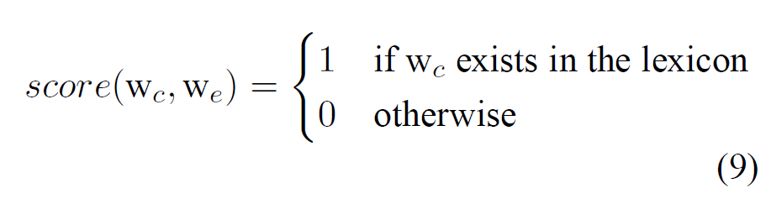
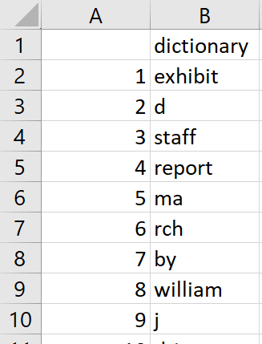
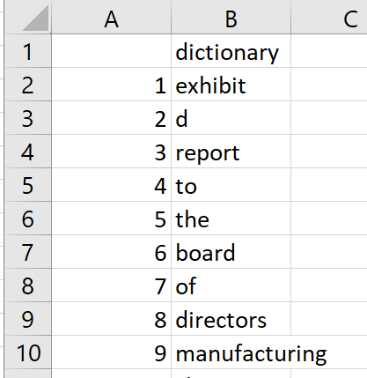
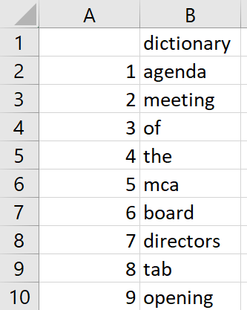
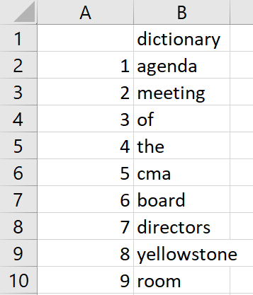
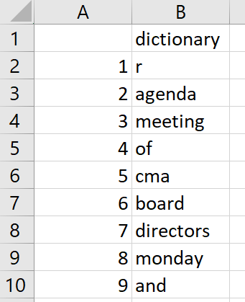
Correction: Statistical Learning Model (Cont.)
Feature 4： Lexicon existance：
A lexicon is corresponding to a topic, so we created our lexicon by the different report groups.
Group 1:
Group 2:
Group 3:
Group 4:
Group 5:

Slide 14
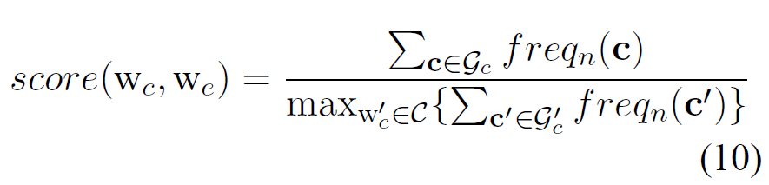
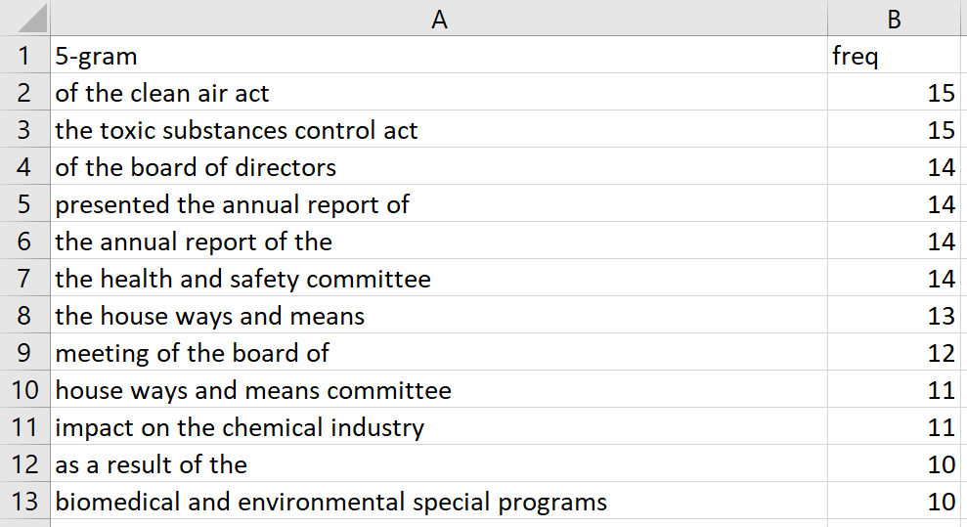
Correction: Statistical Learning Model (Cont.)
Feature 5： Exact-context popularity：
5-gram dictionary：

Slide 15
Challenges
Creating the error-truth pairs

Slide 17
Evaluation

